Slide 1
One day Introductory Workshop on Big Data Methods (on HPC)
MORNING
Introduction of San Diego Supercomputer Center - Data Science (and HPC)
Introduction to SDSC HPC Systems - Comet and Gordon hardware (including simple hands-on job submission)
Introduction to Python
Big Picture of Data Science Approaches and Tools
Description of Hadoop (including hands on with Hadoop)
AFTERNOON
Introductory Spark for Scientific Computing (including hands on with Spark)
Introduction of MongoDB with Pymongo
Introduction of neo4j **
Brief Discussion of Advanced Spark for Scientific Computing
** remote presentation

Slide 2
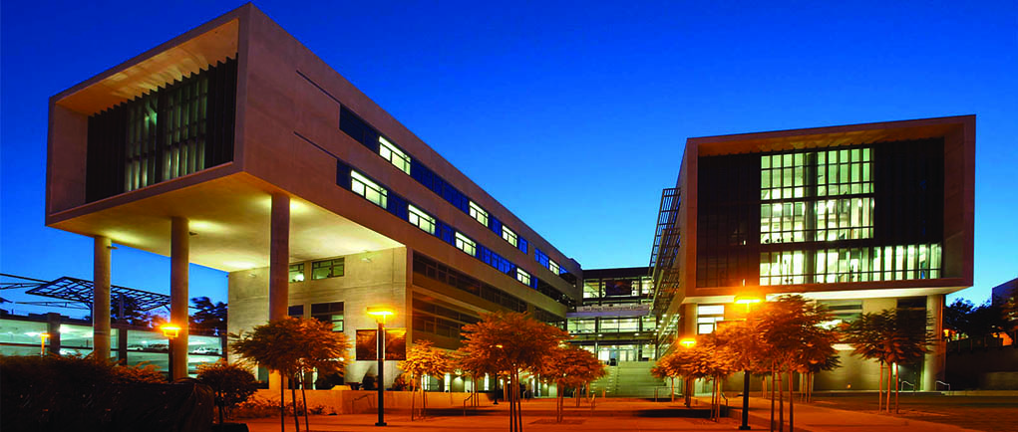
Introduction to SDSC
And its Data Science/Engineering
Amit Majumdar and Amarnath Gupta
San Diego Supercomputer Center
University of California San Diego

Slide 3
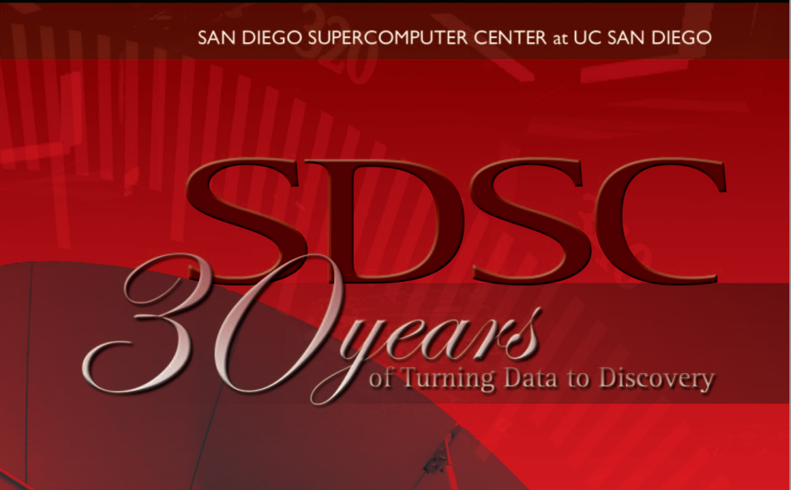
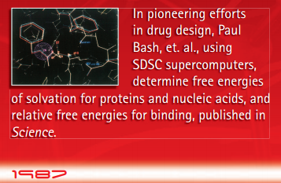
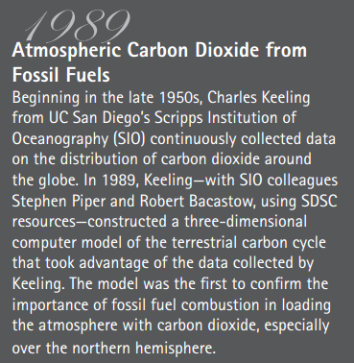
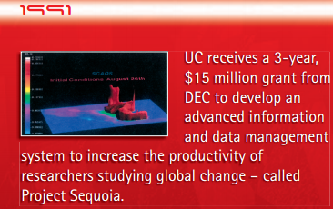
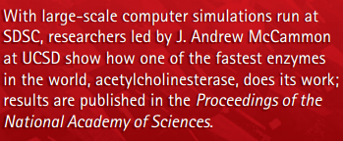

Slide 4
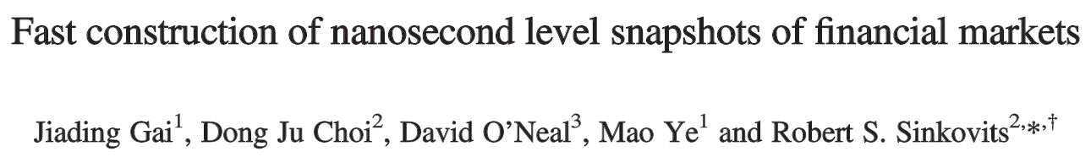
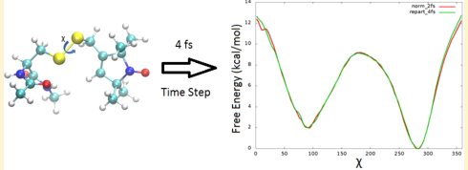
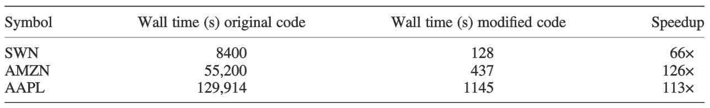
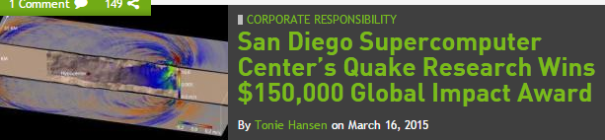
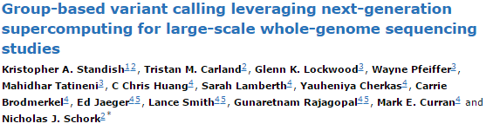
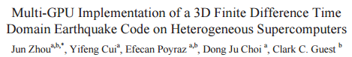
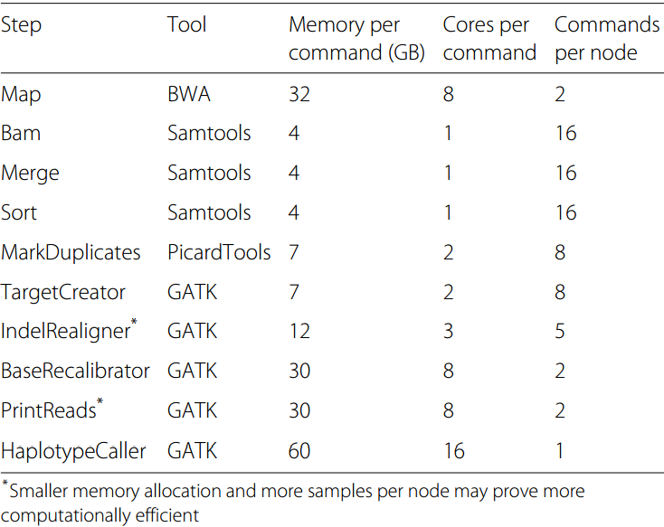
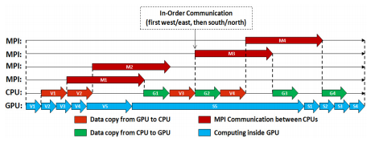
Science and Computing at SDSC
Ross Walker Group
Notes:
To determine the impact of high-frequency trading activity on financial markets, it is necessary to construct nanosecond resolution limit order books – records of all unexecuted orders to buy/sell stock at a specified price. Analysis provides evidence of quote stuffing: a manipulative practice that involves submitting a large number of orders with immediate cancellation to generate congestion.
A limit order book.
Time Weighted Quoted spread • Quoted spread = (best ask-best bid)/2 • Weighted by the time of the quote • Size Weighted Effective Spread • Effective spread • Buy: (Transaction price-midpoint of best bid and ask)*2 • Sell: (Midpoint of best bid and ask- Transaction price)*2 • Weighted by transaction size • Time weighted depth • Number of shares in the best bid and ask of the limit order book • Number of shares within 10 cents of the best bid and ask • Weighted by time
Sorting
When sorting a single whole human genome, upwards of 800 temporary files are generated, totaling up to 150 GB per genome. These files are repeatedly opened, read, written, and closed, imposing demanding IO performance. To fully utilize the sixteen CPU cores on each node, a single compute node must be capable of processing 2.4 TB of intermediate data spread across over 10,000 files. we utilized 2 “BigFlash” nodes, each with 4.4 TB of SSD flash storage.
Realignment/Recalibration
When running, we allotted ~8 GB of memory per genome, allowing us to process 8 samples on a 64 GB node. Thus, 2 cores were designated for each instance of MarkDuplicates. This approach prevented the possibility of multiple job submissions exceeding the available memory and causing run errors. The RealignerTargetCreator step was similarly designated 8 GB of memory per genome and IndelRealigner steps utilized 12 GB of memory per genome, so 8 and 5 samples were run on a single node, respectively. This approach prevented memory allocation errors arising from memory exhaustion. BaseRecalibrator, on the other hand, could be run in parallel and was multithreaded to 8 cores per genome. Finally, PrintReads was run in parallel over 8 or 16 cores. When we established that specifying 16 computing threads yielded no performance increase, subsequent jobs were multithreaded over 8 cores
Given the extraordinary amount of data being processed and generated, it is important to remove large, intermediate files after subsequent processing has been completed to minimize required storage resources.

Slide 5
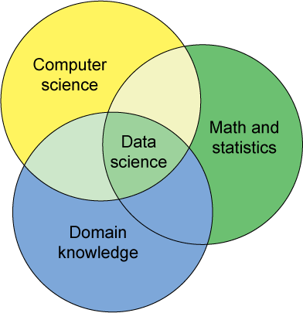
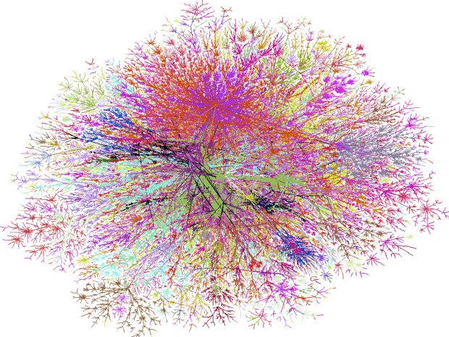
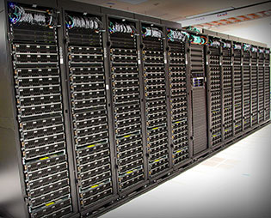
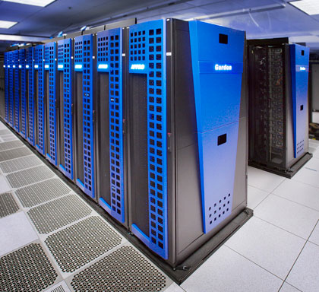



Definition of Data Science is Evolving
BIG DATA
ON-DEMAND COMPUTE
Allows for data-enabled decision making at scale
Many current and future applications with dynamic and measurable impact!
Notes:
Definition of data science is changing with big data and access to on demand computing.

Slide 6
APPLICATION-SPECIFIC KNOWLEDGE and QUESTIONS
?
BIG DATA
ON-DEMAND COMPUTE
Allows for data-enabled decision making at scale, using data management, statistics, data mining, graph analytics, etc.
Requires support for experimental work by a multidisciplinary group of experts and dynamic scalability on many platforms!

Slide 7
Interpret results
Summarize results
Visualize results
Post-process results
Analyze data
Process data
Clean data
Integrate data
Subset data
Pre-process data
Find data
Access data
Acquire data
Move data
“Big” Data Engineering
Computational “Big” Data Science
ACCESS
MANAGE
ANALYZE
REPORTxdhd
SDSC Data Platform
SDSC Computing Systems
Data Management
Graph Analytics
Hadoop Stack
Information Vis
Exploratory Analysis
…..
Gordon – SSDs
Comet – Large Mem.
Compute Cloud
Hadoop/Spark Cluster
…..
NETWORKING and STORAGE CI

Slide 8
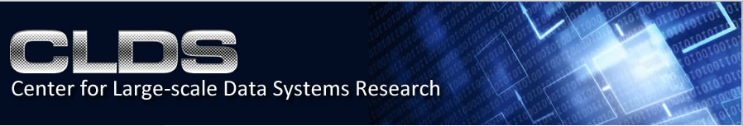

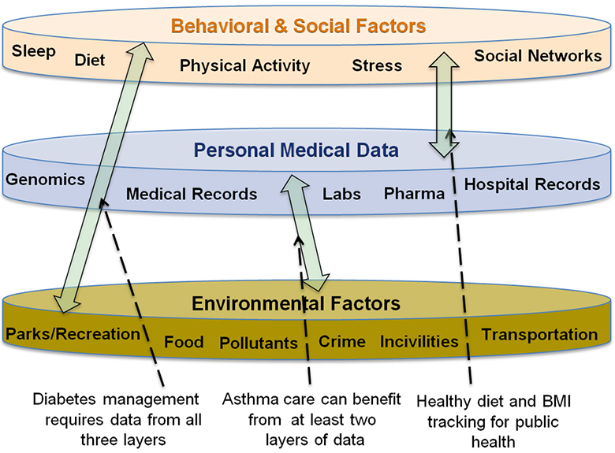
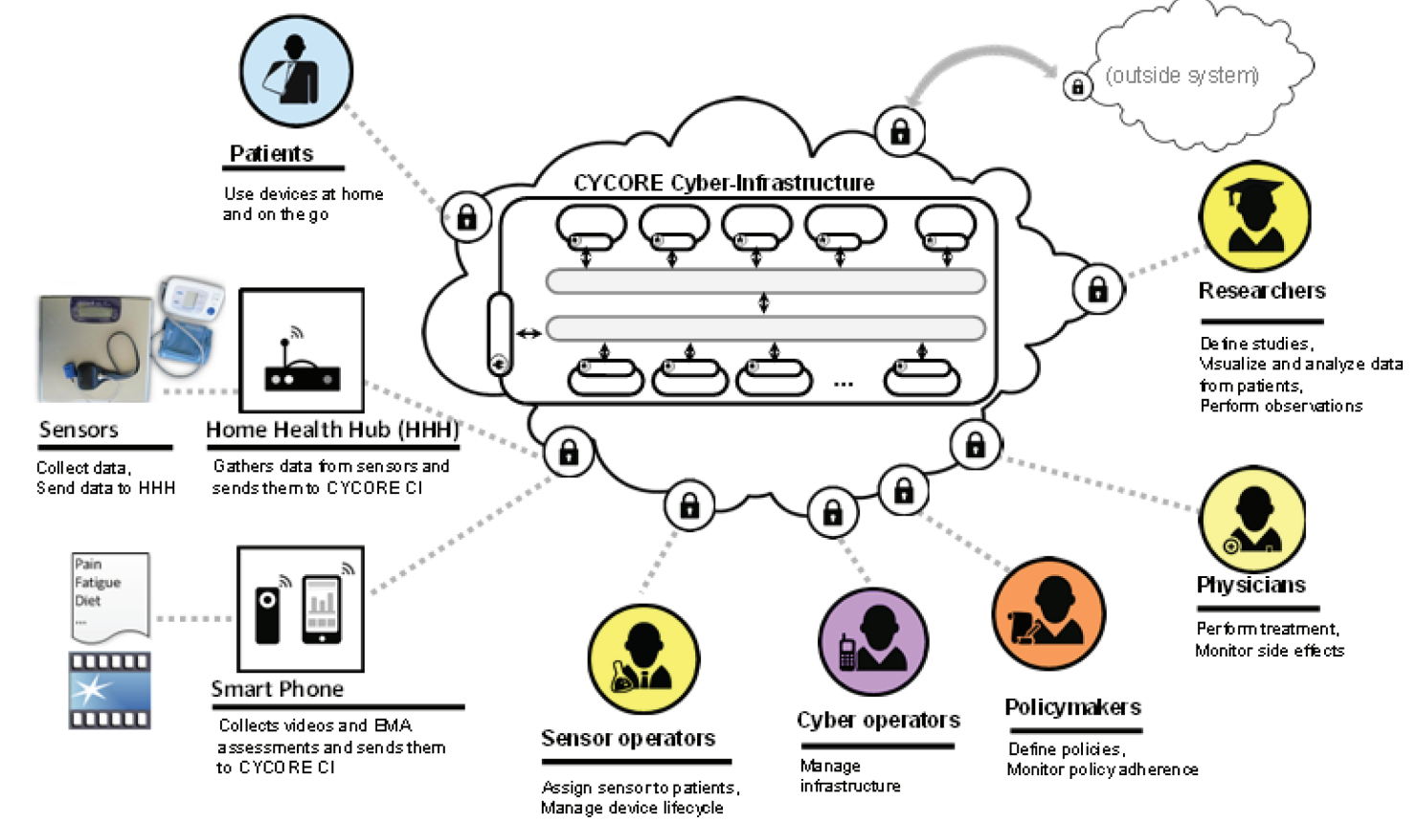
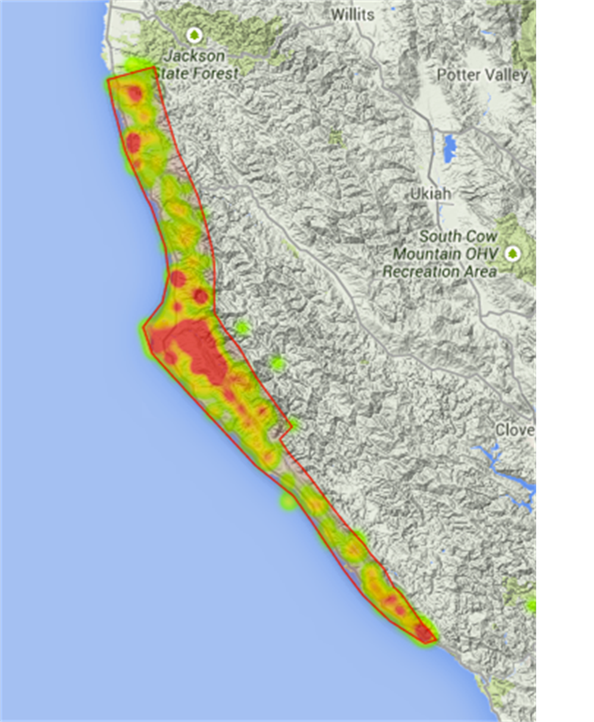
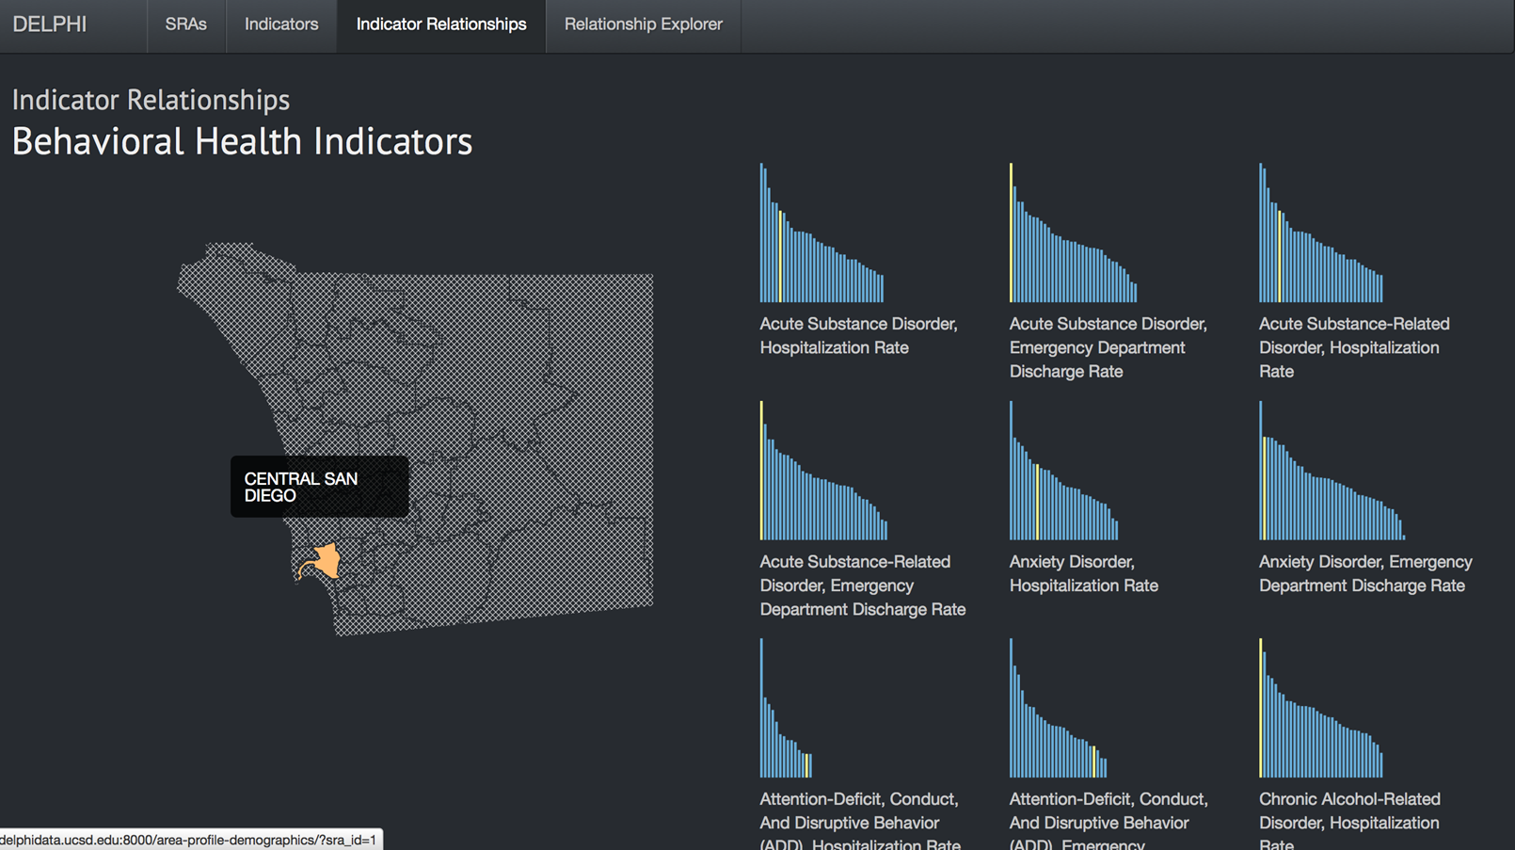
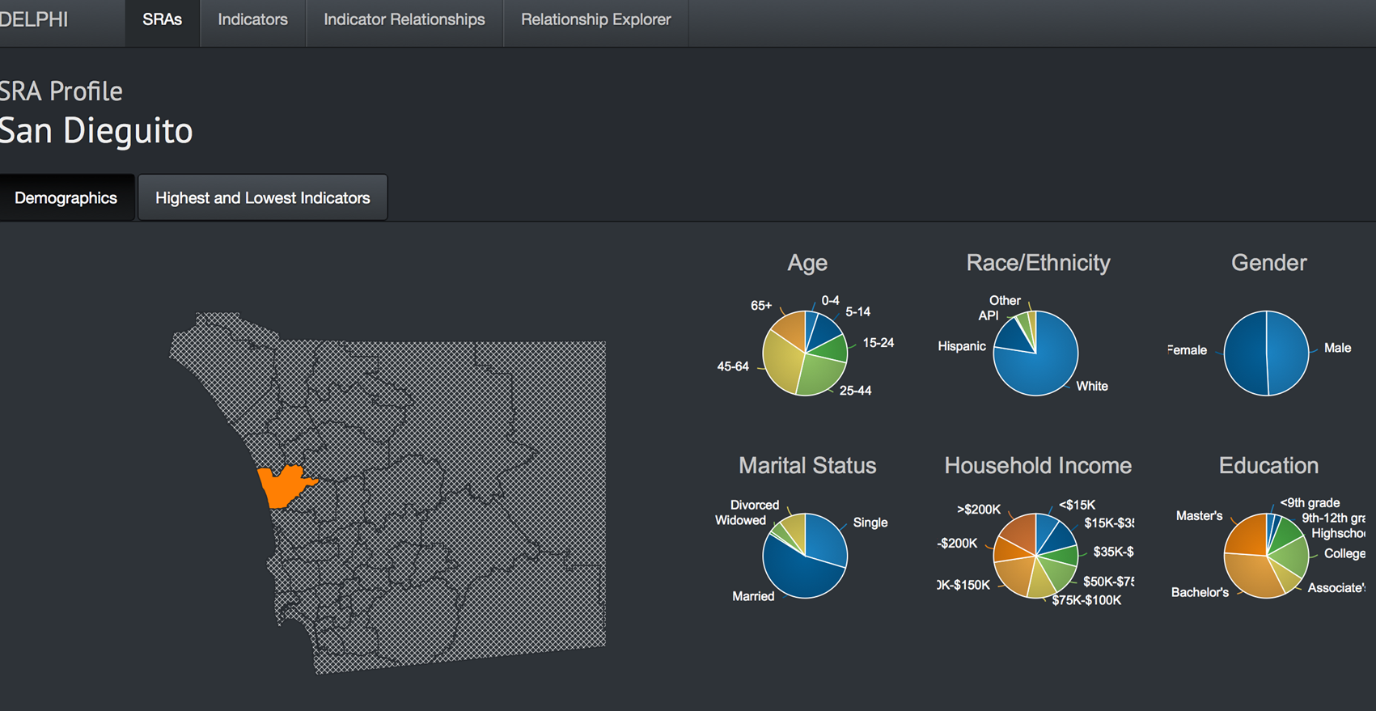
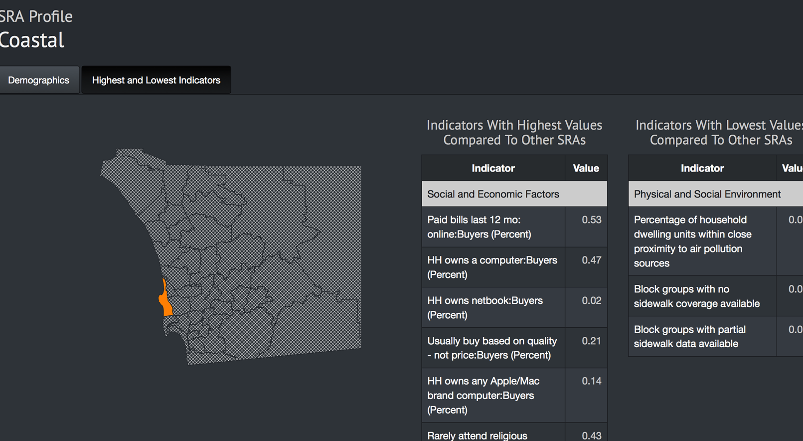
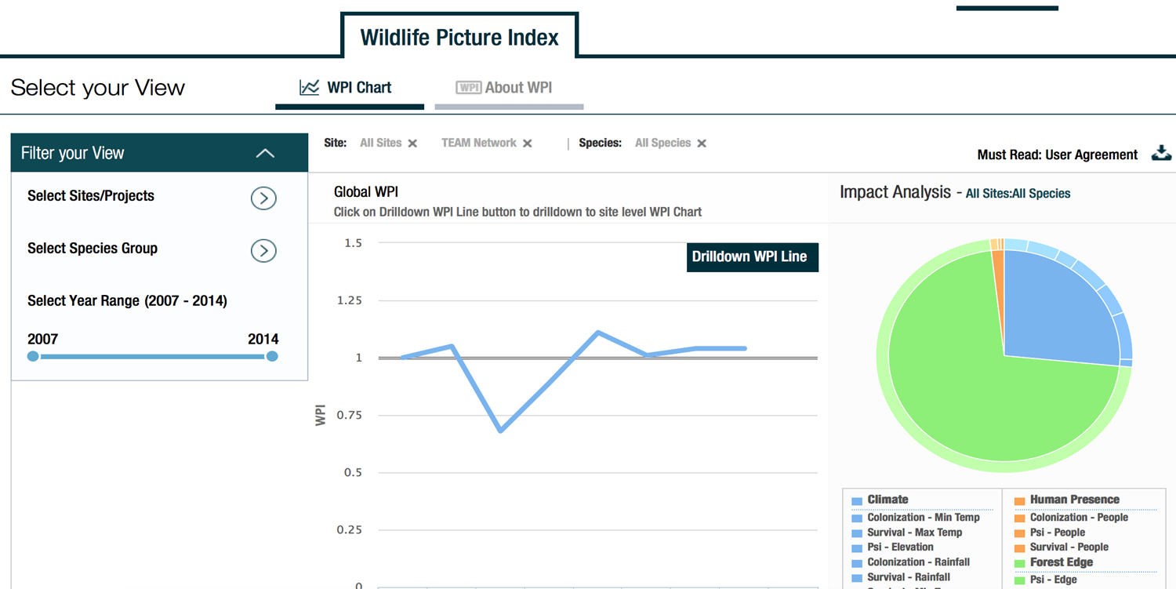
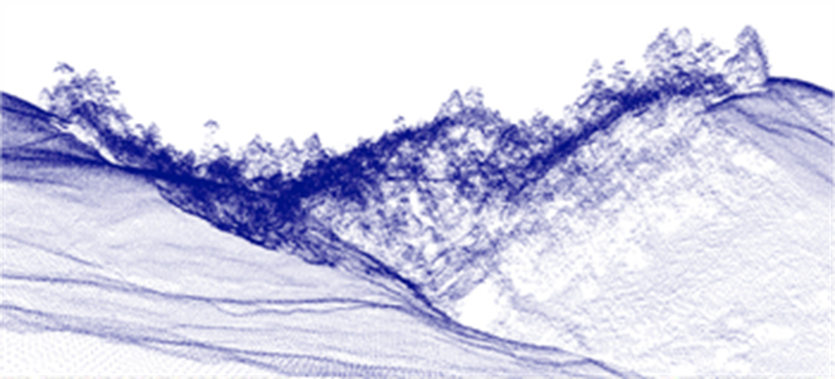
Sensing Health for Treatment Effectiveness
Real-time Data Management
Multimedia Data Acquisition
Dense Data (e.g., LIDAR) Management with DBMS
Data Warehousing
Systems Integration
Large-Scale Data Infrastructure
Lidar Point Cloud Job Recommendations
Monitoring Wild Life with Videos
Notes:
LIDAR – Light Detection and Ranging is a remote sensing method used to examine the surface of the Earth.
DELPHI Data E-platform Leveraged for Patient Empowerment and Population Health Improvement (DELPHI),

Slide 9
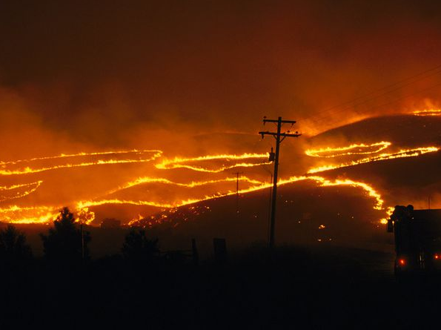
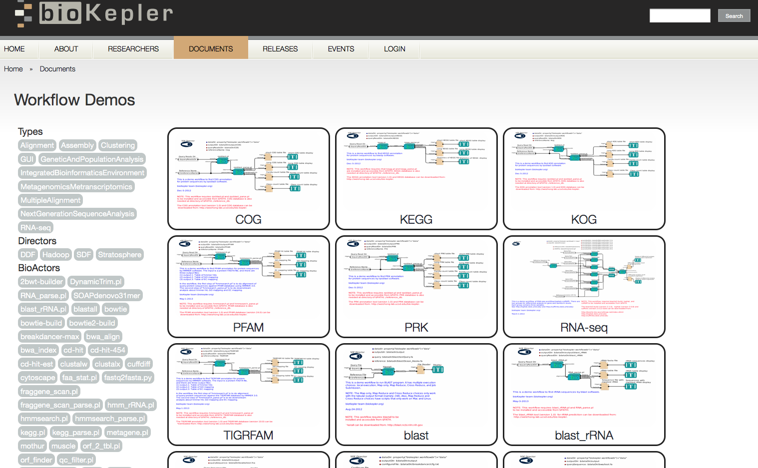


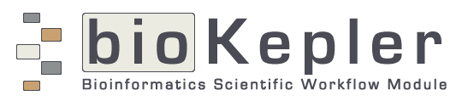
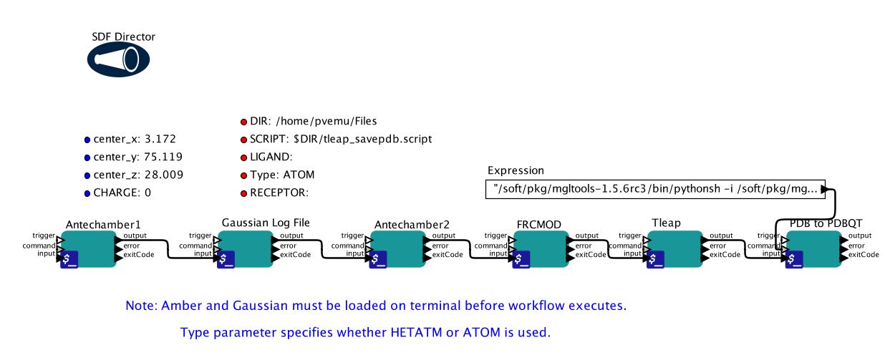
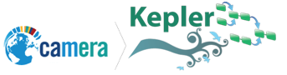

Workflows for Data Science (WorDS) Center at SDSC - Programmable, Reusable and Reproducible Scalability -
WorDS.sdsc.edu
Real-Time Hazards Management
wifire.ucsd.edu
Data-Parallel Bioinformatics
bioKepler.org
Access and query data
Scale computational analysis
Increase reuse and reproducibility
Save time, energy and money
Formalize and standardize
kepler-project.org
Technologies
Focus on the question,
not the technology!
Applications
Development
Scalable Automated Molecular Dynamics and Drug Discovery
nbcr.ucsd.edu
Notes:
Each DDP pattern defines its execution semantics, i.e., how data is partitioned and processed by the pattern. This clear definition enables decoupling between a DDP pattern and its execution engine. To execute DDP workflows on different DDP execution engines, we have implemented a DDP director in Kepler. Currently, this director can execute DDP workflows with either Hadoop or Stratosphere.
For DDP actors containing a sub-workflow, the Kepler engine is called with the partitioned data to process sub-workflows in the Stratosphere jobs.

Slide 10
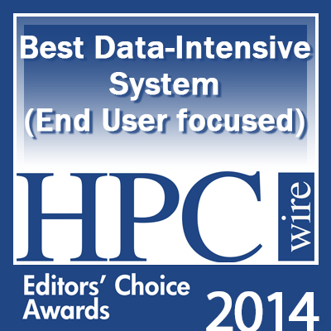
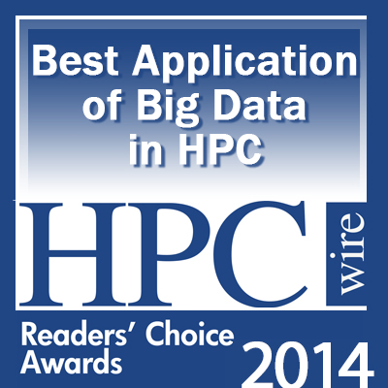
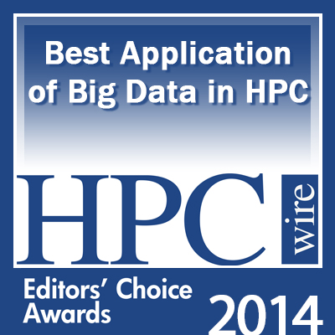

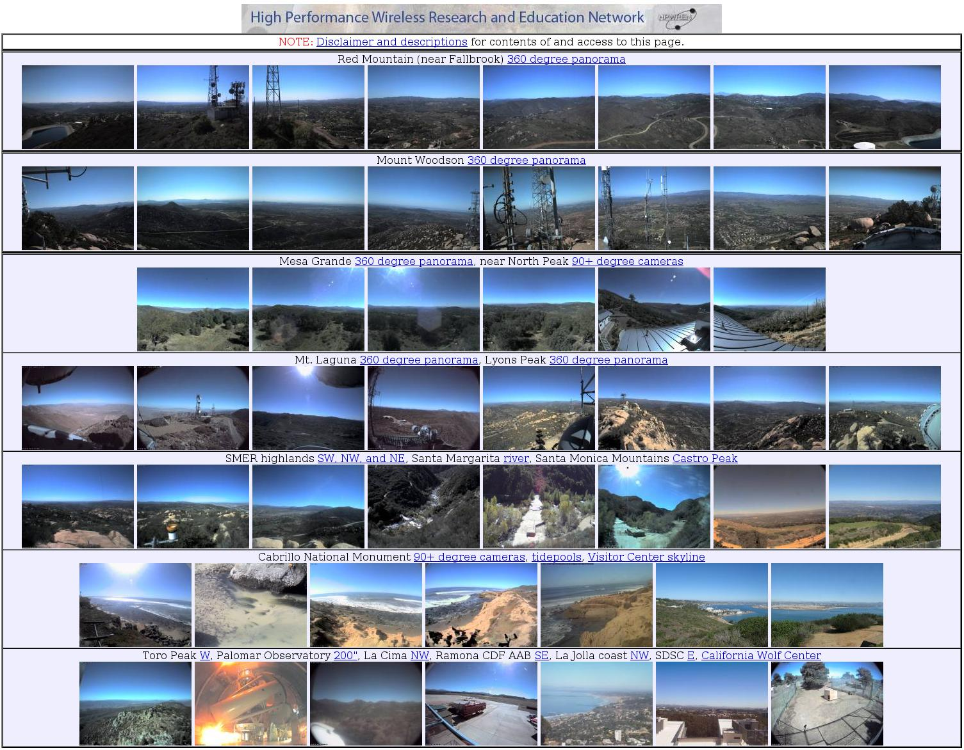
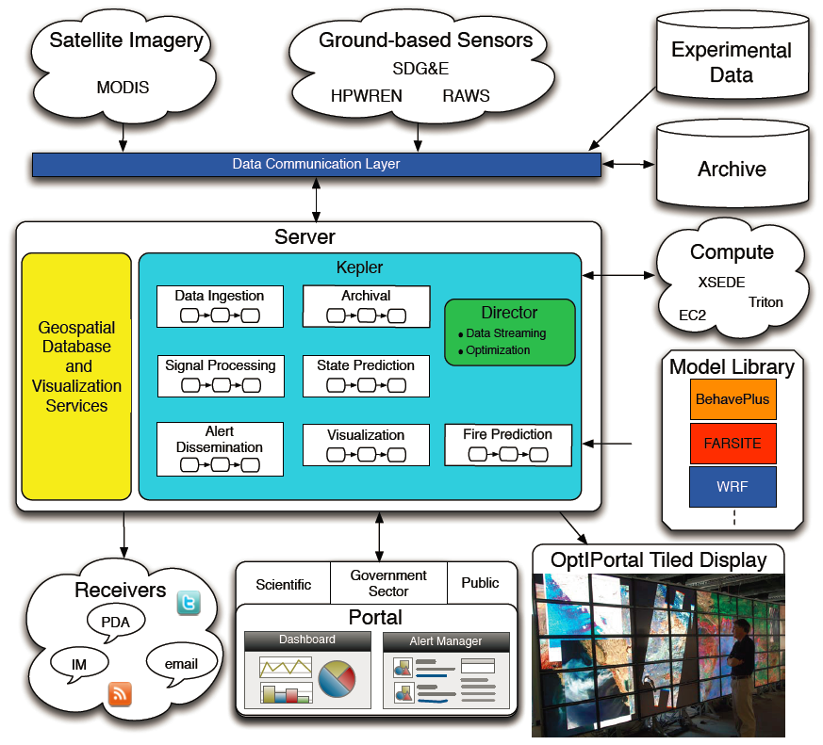
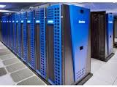

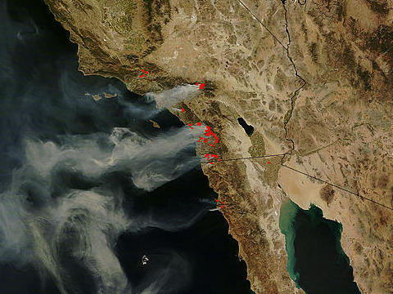
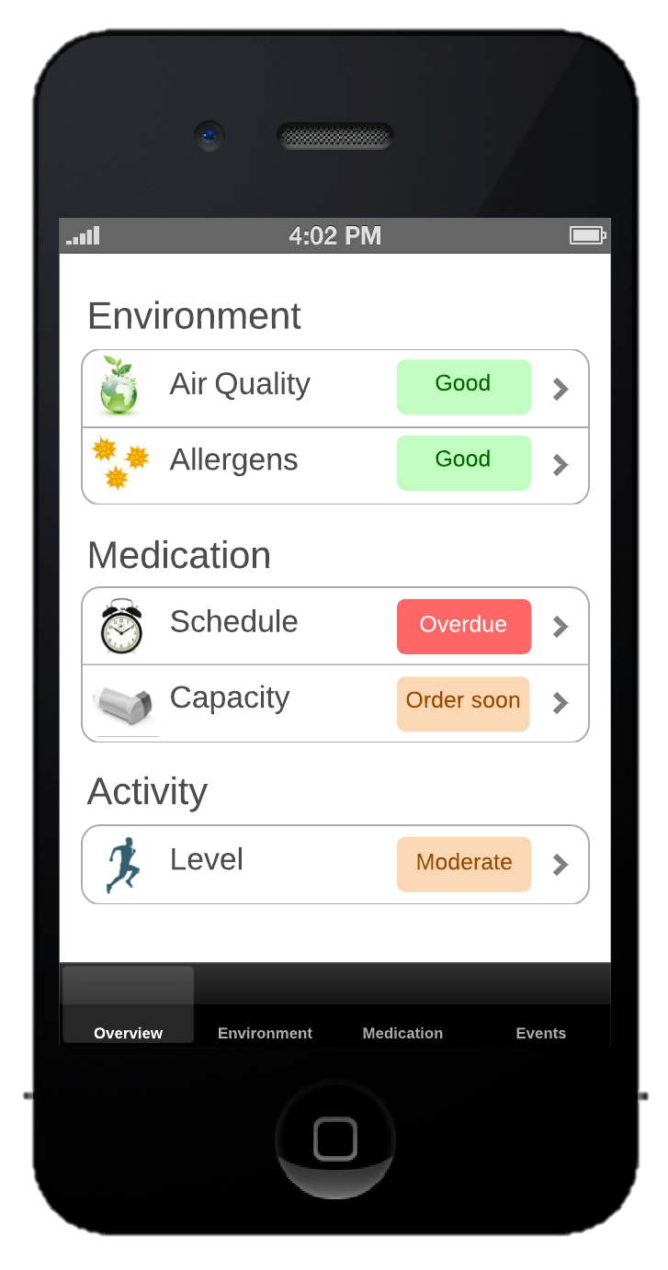
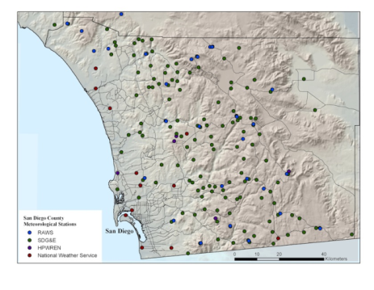
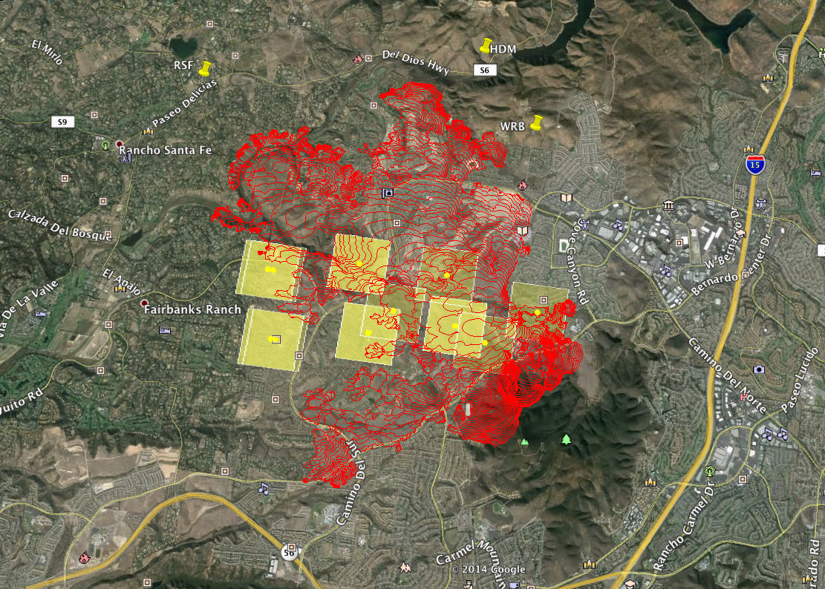
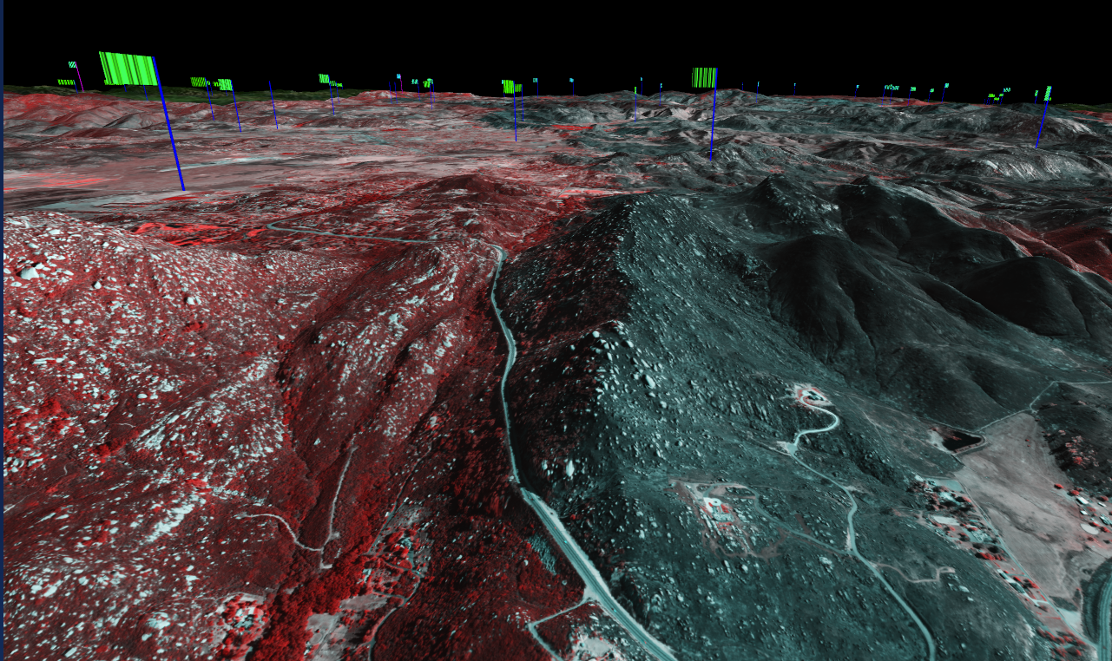
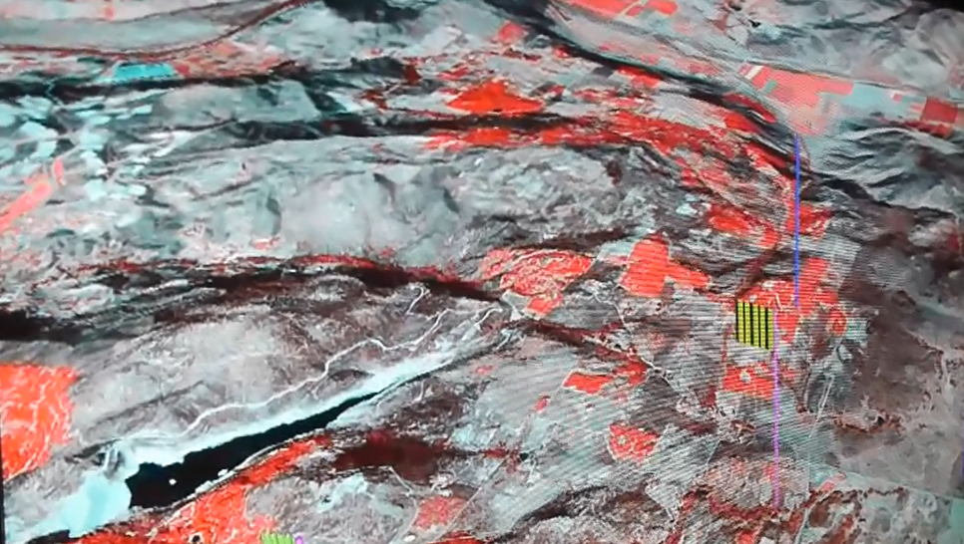
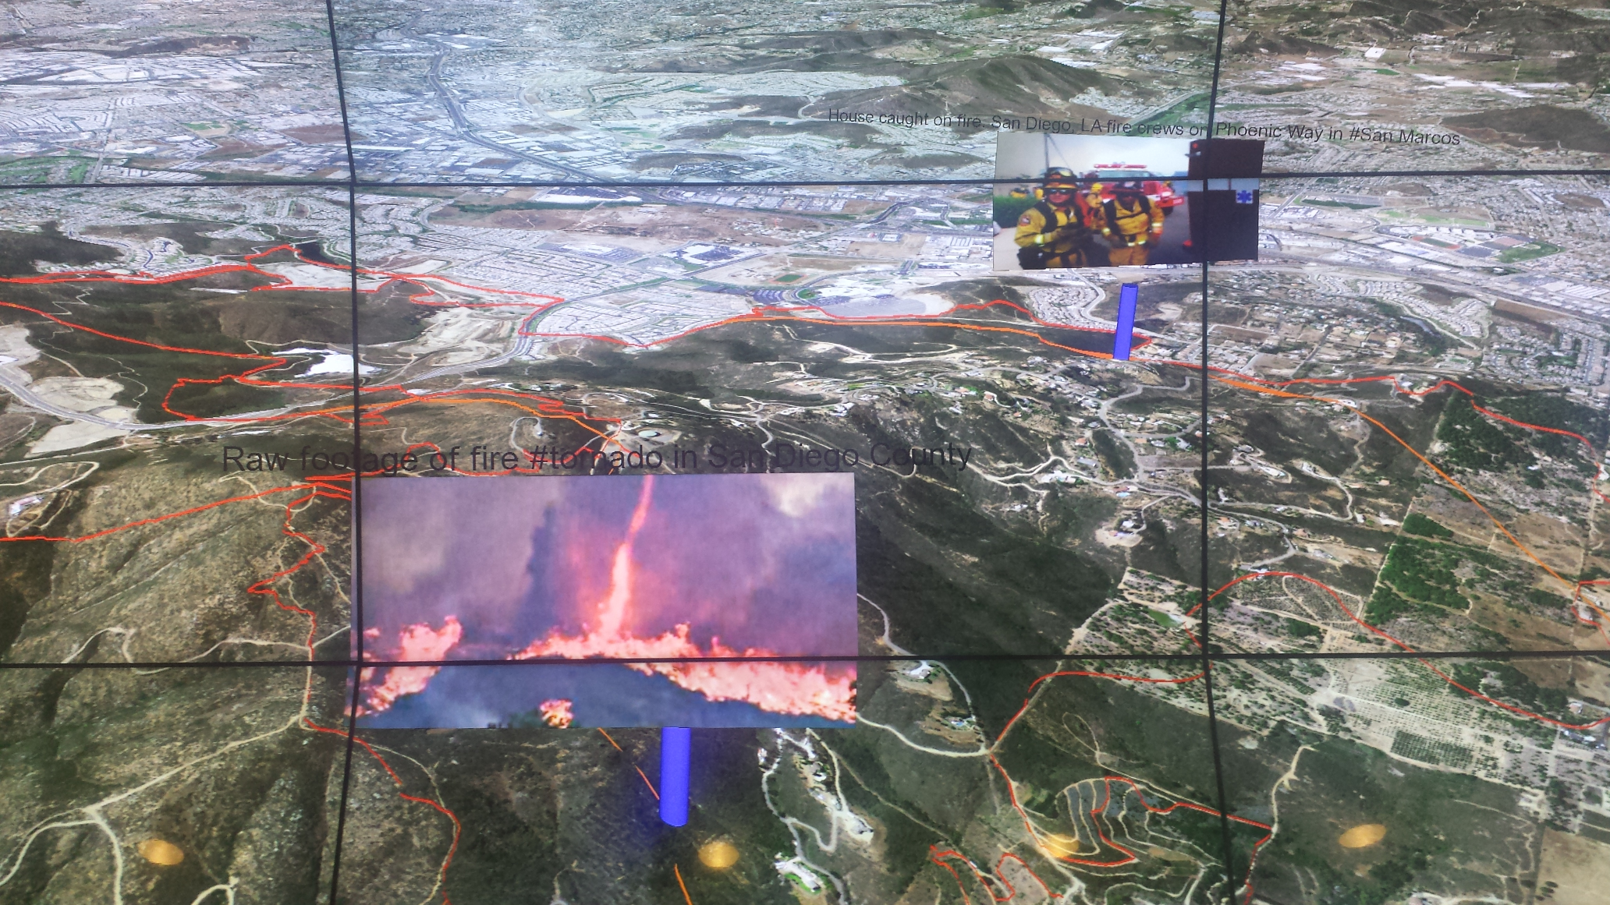
Monitoring
Big
Data
Visualization
Fire Modeling
wifire.ucsd.edu

Slide 11
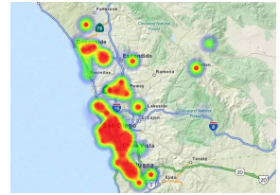
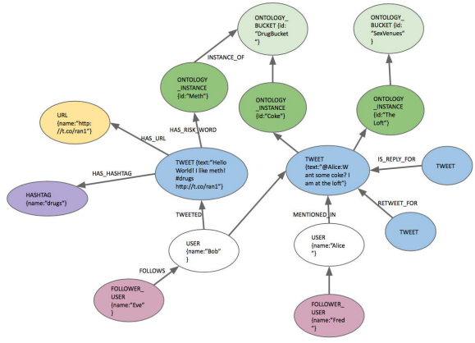


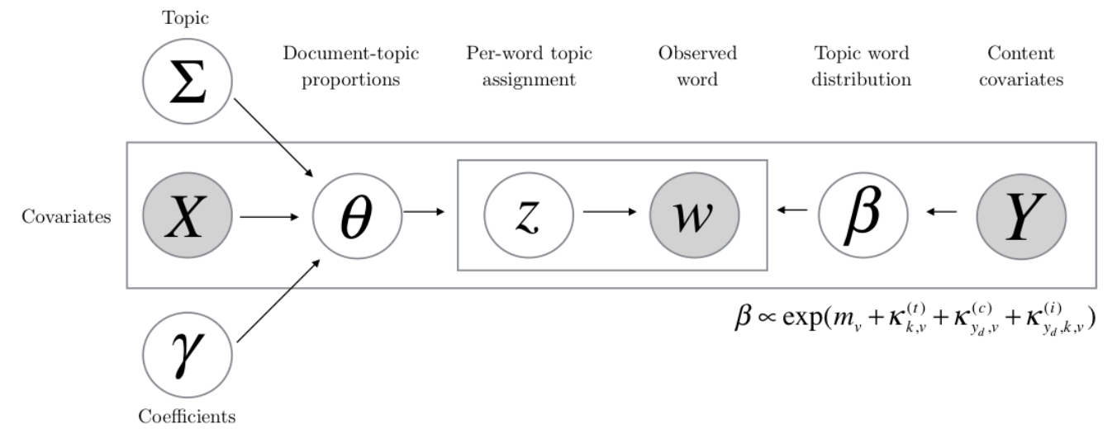

AWESOME: A Workbench for Exploration of Social Media - A Polystore-Based Big Data Platform for Social Media Data -
At-risk HIV Candidates in San Diego
AQP.sdsc.edu/AWESOME
Graph Data Analytics
Advanced Query Processing Lab
Heterogeneous Data Integration
Large-Scale Ontology Processing
Knowledge-based Search Engine
Query Processing on Graph Data
Event Modeling with Spatiotemporal Data
Parallelized Structural Topic Model
Information Discovery using Domain Knowledge
www.neuinfo.org

Slide 12

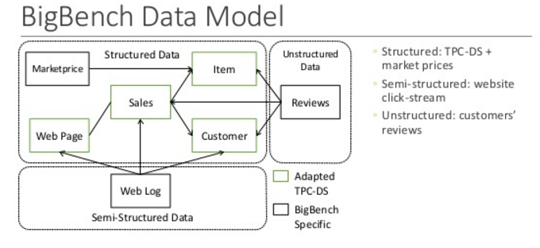
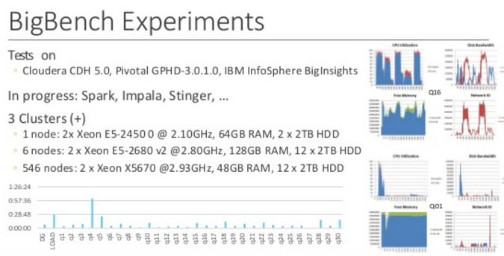

Big Data Benchmarking
Initiated via an NSF Clue grant
Spinoff from the NSF Open Topography project
Test idea of storing all data in a scientific data archive in Hadoop, while “caching” working set data in a relational database
New TPC benchmarks are introduced
BigBench – a new big data benchmarking effort with the industry
Initiated new ideas
Deep Analytics Pipeline model for benchmarking Big Data/Data Science workloads
Creation of a BigData Top100 List
Referenced in NSF solicitation on Benchmarks of Realistic Scientific Application Performance of Large-Scale Computing Systems (BRAP)
Collaborations
Open to collaboration in this area, e.g. identifying applications scenarios and defining corresponding benchmarks
Designing challenges and competitions—perhaps with industry collaboration
Chaitan Baru, baru@sdsc.edu

Slide 13
Convergence of Big Data and HPC – Research
May be you will have your own research ideas on this topic of convergence of Big Data and HPC
Infiniband HPC clusters RDMA based Apache Hadoop, Spark
Co-processors (eg GPU, Intel MIC) Big data platforms needs faster processing for complex analytics
Big Data leads to public Cloud HPC Cloud
New mathematical, statistical algorithms for Big Data Will need to be implemented on HPC
High energy physics, astronomy, genomics Doing big data + HPC for a long time
How to inject analytics intensive workload into HPC systems
Hadoop and HPC Lustre and HDFS

Slide 14
Thank you

